Slide 1

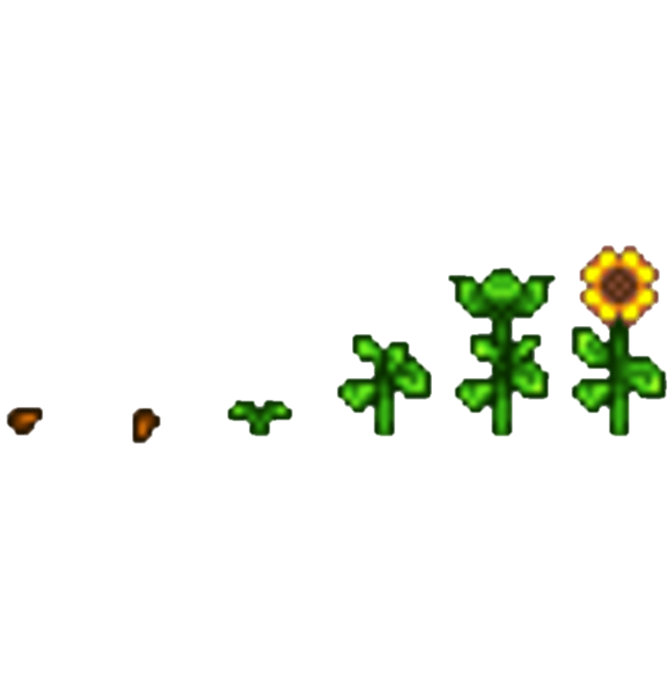
Stardew Valley
THE STRUGGLES OF SOLO DEVELOPERS
Yatai Tian
yataitian@gmail.com
ytia165@aucklanduni.ac.nz
Notes:
WELCOME

Slide 2




Interests and Hobbies
Stardew Valley (Farming + more!)
Teamfight Tactics (Auto Battler)
Valorant (First Person Shooter)
Data Visualization
Creating Future Technology
Notes:
This section is NOT assessed. We just want to get to know you ☺. (ya sure about that)

Slide 3

Data Science
The search for greatness

Slide 4

Best part of MSA
Learning!
Juypter Notebook
API calling
Mid-sem work

Slide 5

What MSA can improve on?
Virtual Machine and the benefits
Thoroughly enjoyed it all
Notes:
Tutorial on setting up Virtual Machine and the benefits

Slide 6



Future Goals
Actively learning
R, Python and SQL
Data Science: Class and Packages
More Projects
Notes:
Data visualization and communication, multivariable calculus and linear algebra, programming skills, stats, machine learning. Become more comfortable in R PYT SQL.

Slide 7




Motivation
Solo developers
Update their game (free)
Find bugs
Build something else
Eric Barone
Notes:
Games are cool

Slide 8
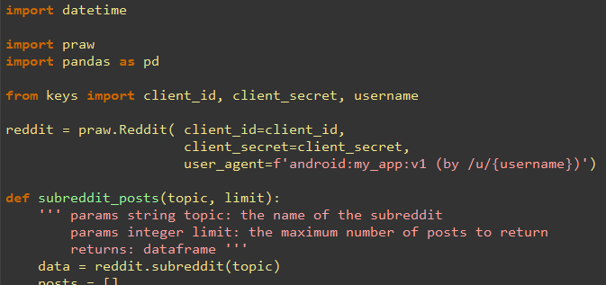
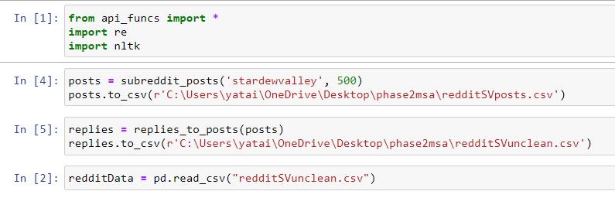
Data Extracting
API calling using prebuilt package
Notes:
Talk about your database, what schema you used and what data you used

Slide 9
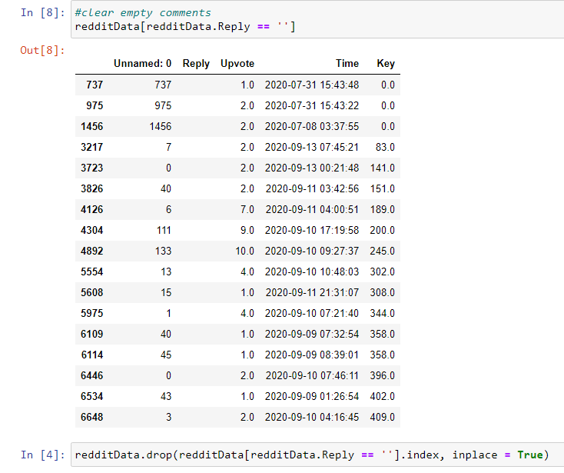
Data Cleaning
Removing links
Removing tagging users, bots and subreddits (u/, U/, r/, R/)
Removing empty replies

Slide 10
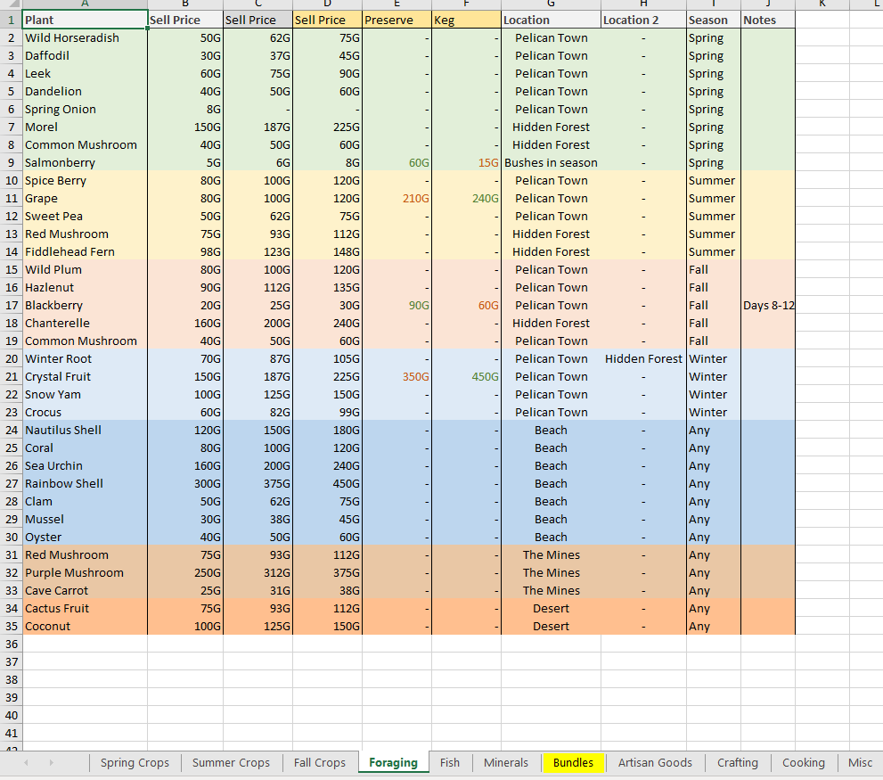
Data Cleaning
Check commonly used terms in Stardew Valley
Notes:
EXTRACTED EXCEL FROM REDDIT, OUTPUT TO CSV AFTER THIS STEP AND INTO R

Slide 11
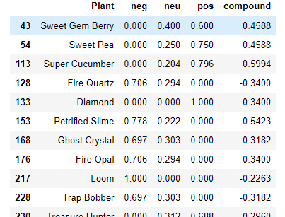
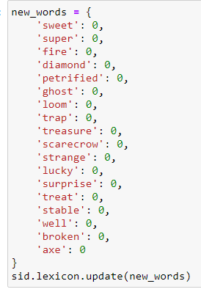
Data Cleaning
Notes:
EXTRACTED EXCEL FROM REDDIT, OUTPUT TO CSV AFTER THIS STEP AND INTO R

Slide 12
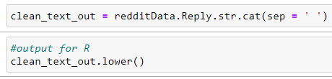
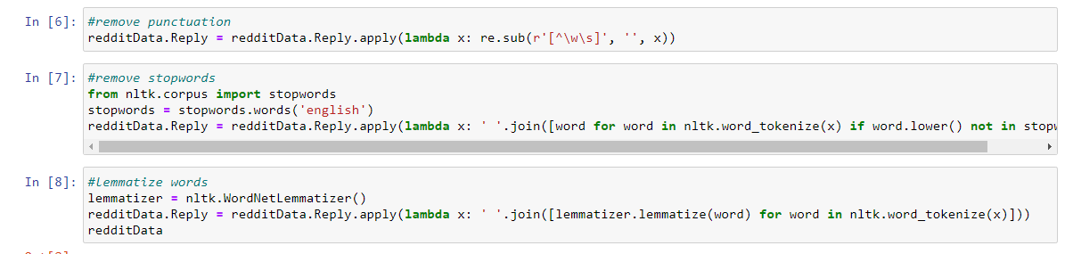
Data Cleaning
Remove punctuation
Remove stop words
Lemmatize words

Slide 13
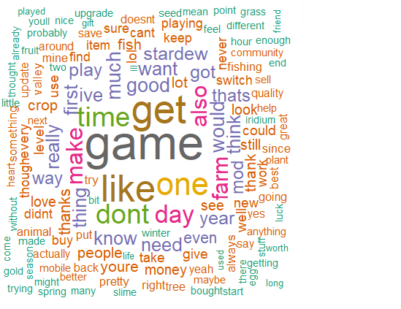
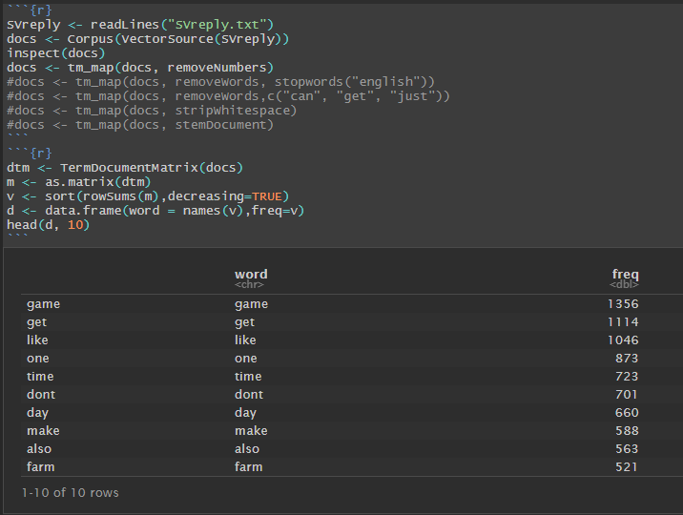
Data Exploration
Finding most common words in replies

Slide 14
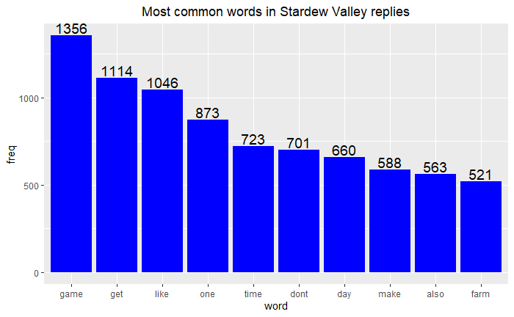
Data Exploration
500 Posts

Slide 15
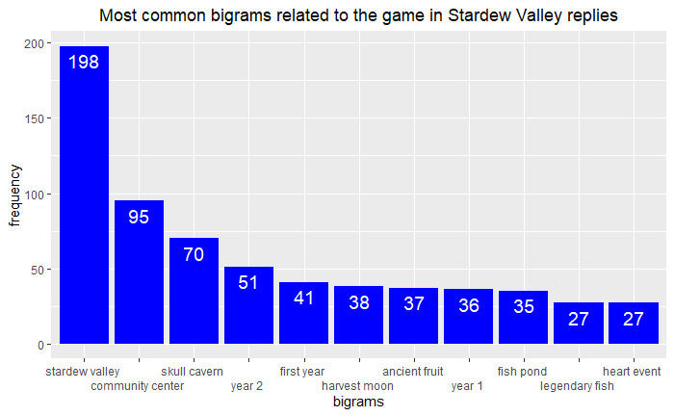
Data Exploration

Slide 16
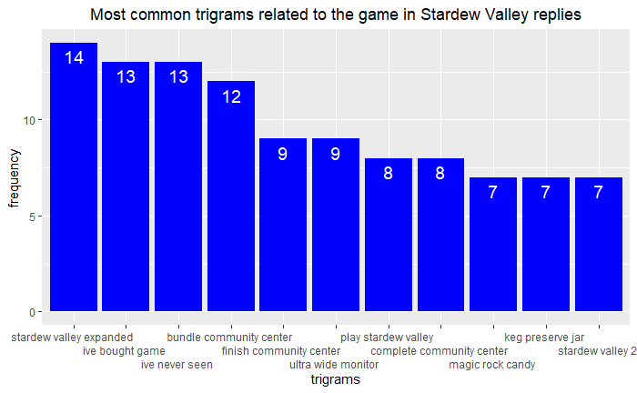
Data Exploration

Slide 17
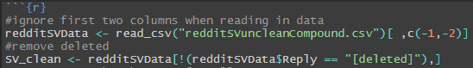
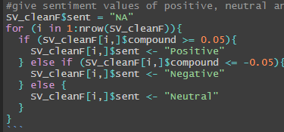
Sentiment Analysis
Last minute clean with deleted comments
Used common values in vader Github to subset compound data
Notes:
Explain your Azure features here

Slide 18
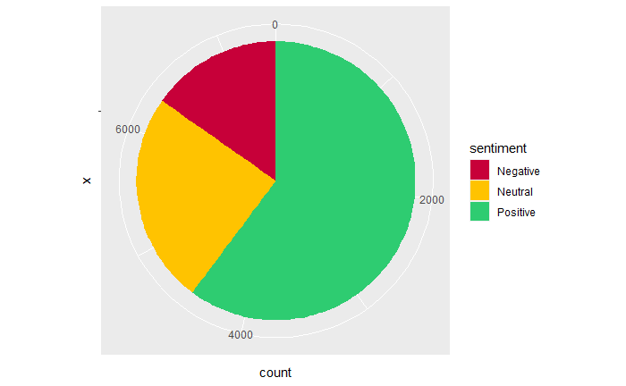
Sentiment Analysis
15.3%
24.5%
60.2%
Notes:
Explain your Azure features here

Slide 19
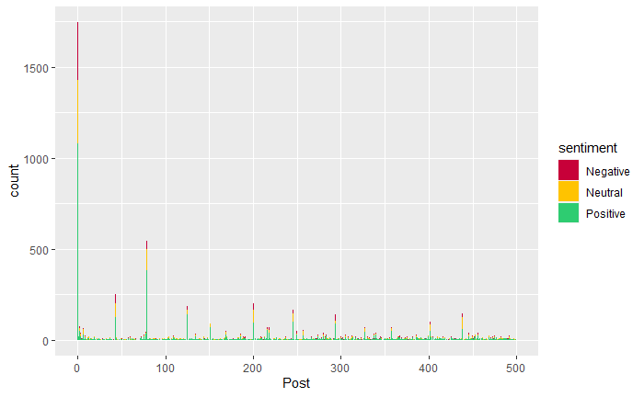
Sentiment Analysis
Notes:
First post was FAQ so lots of comments

Slide 20
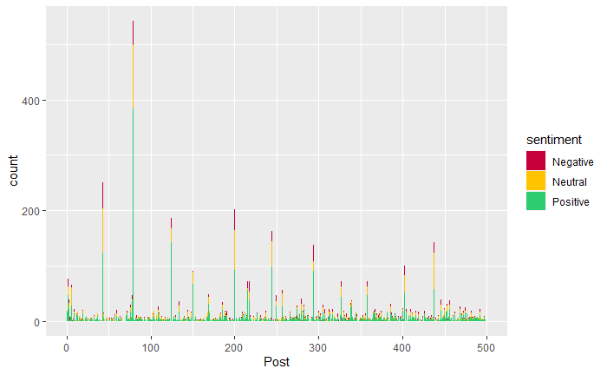
Sentiment Analysis
Notes:
Removed first post

Slide 21
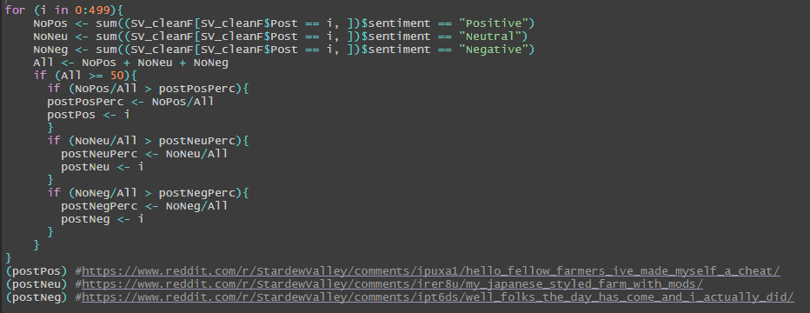
Sentiment Analysis
Notes:
Note the 50

Slide 22
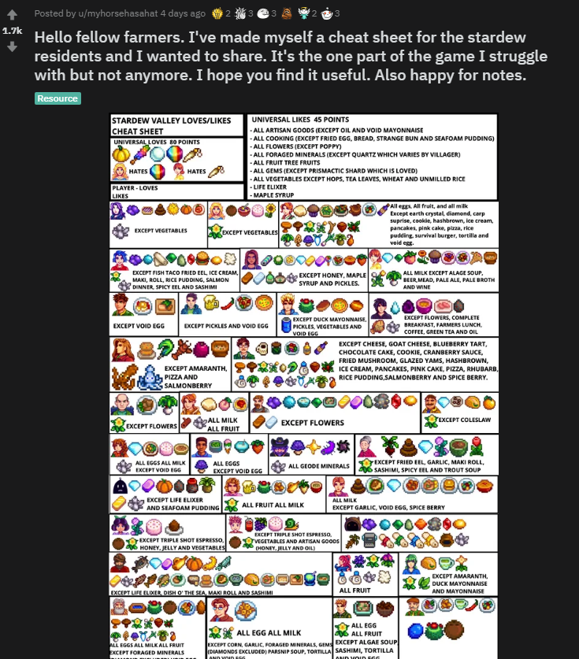
Sentiment Analysis
Most Positive Post Replies (79% pos)

Slide 23
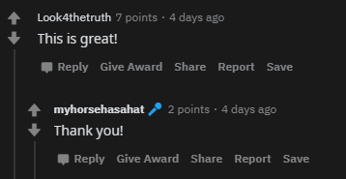

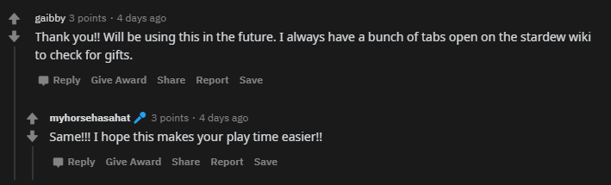
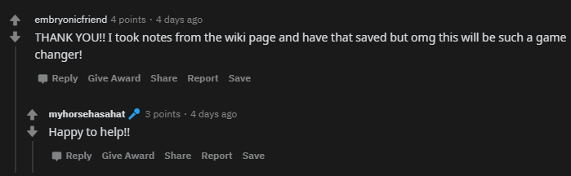
Sentiment Analysis
Most Positive Post Replies (79% pos)

Slide 24
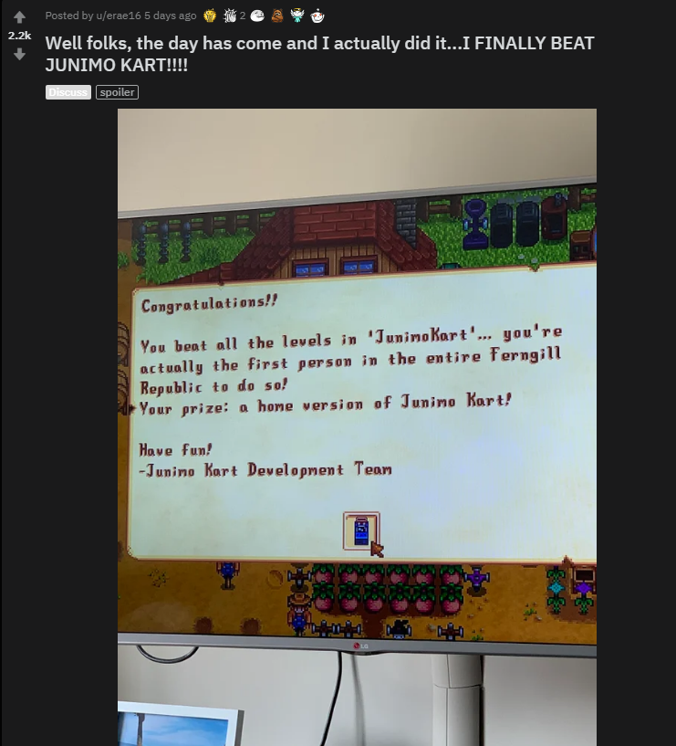
Sentiment Analysis
Most Negative Post Replies (25% neg)
Notes:
Note the 50

Slide 25
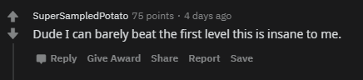
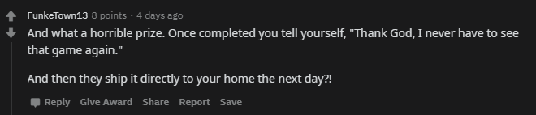



Sentiment Analysis
Most Negative Post Replies (25% neg)
Notes:
Note the 50

Slide 26
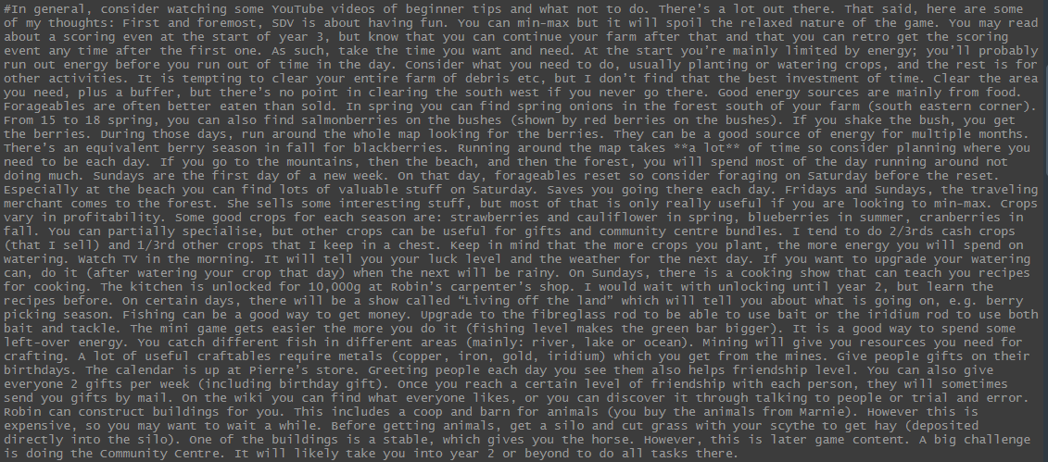
Sentiment Analysis
Highest compound score (0.9987)
“SDV is about having fun”
“Relaxed nature of the game”
“Good energy sources are mainly from food”
“Crops vary in profitably”
“Good crops”
“Fishing can we a good way to get money”
“Find what everyone likes”
“It is a good way…”
Notes:
Negative because talking about beating a game, "beaten" is a negative word but in this context it refers to passing a game. Compound score for "beaten" only is -0.4215. Examples of this in comments is "Have you beaten journey of the prairie king too?", "Dude I can barely beat the first level this is insane to me" and "I have only gotten to the mushroom level. I have beaten the prairie king though". Furthermore, using words that could mean different things in different context such as "You're actually insane" scored -0.4019 although it was a compliment. Funnily enough ":o" scores a negative sentiment score too.

Slide 27
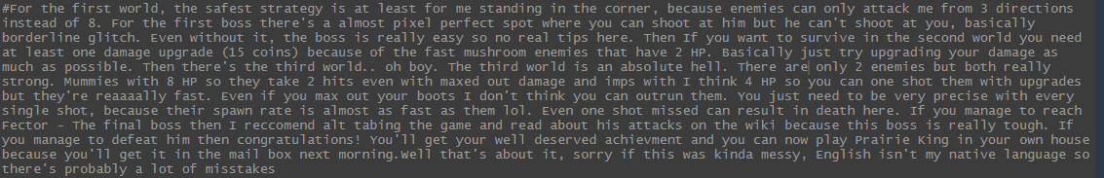
Sentiment Analysis
Lowest compound score (-0.9864)
“Because enemies can only attack me from…”
“Where you can shoot at him but he can’t shoot at you”
“At least one damage upgrade”
“Is an absolute hell”
“only 2 enemies”
“2 hits even with maxed out damage”
“missed can result in death here”
Notes:
Note the 50

Slide 28
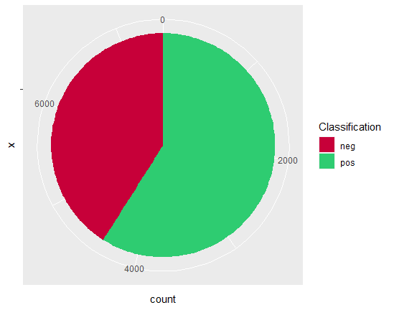
Sentiment Analysis
TEXTBLOB VS VADER
15.3%
41%
24.5%
59%
60.2%
Notes:
Just over 1% difference for positive, seems like neutral changed to neg

Slide 29
Sentiment Analysis
Reply differences between two packages
Reply | Vader | Textblob
If I divorce will my ex spouse dislike me? I just hate the nursery room. | -0.7430 | pos
What happens if you’re dating 2 ppl same time and you marry one of them? Do you break up after ceremony and drop hearts or still dating unless you manually break up? | 0.7476 | neg
Where do I get green tea from? AmI missing it or something? | -0.3736 | pos
Notes:
Just over 1% difference for positive, seems like neutral changed to neg

Slide 30

Data/Sentimental Analysis
NEXT STEPS
Too many game related terms for sentimental analysis
Have a different subreddit for game suggestions
Alert the developer when the post gets a certain number of upvotes
Taking the top posts per week
Notes:
Take the top 10 + any leftover over 500 upvotes etc

Slide 31
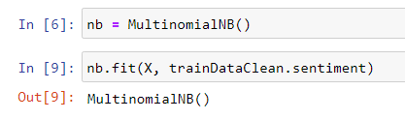
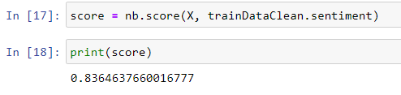
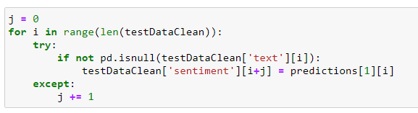

Kaggle Challenge
Tutorial was great
Exposure to Python packages
Notes:
Advanced features… challenges is spent a day getting the predictions to line up with the data.

Slide 32
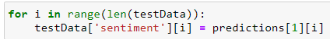
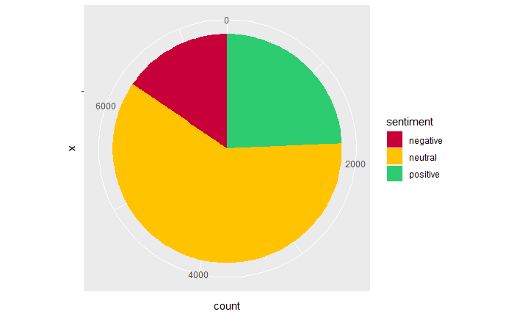
Advanced Requirements
1)
2)
Notes:
Advanced considerations…

Slide 33
Sentiment Analysis
VADER vs OWN MODEL
15.3%
15.5%
24.3%
24.5%
60.2%
60.2%
Notes:
seems to be less words to train so there is more neutral

Slide 34
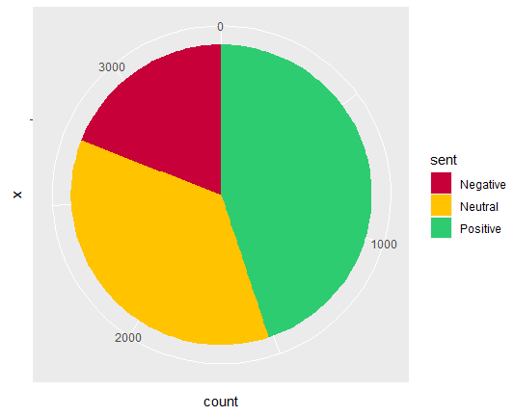
Sentiment Analysis
StardewValley (Vader) vs StardewMemes (Vader)
15.3%
19.1%
24.5%
44.9%
60.2%
36.0%
Notes:
seems to be less words to train so there is more neutral

Slide 35
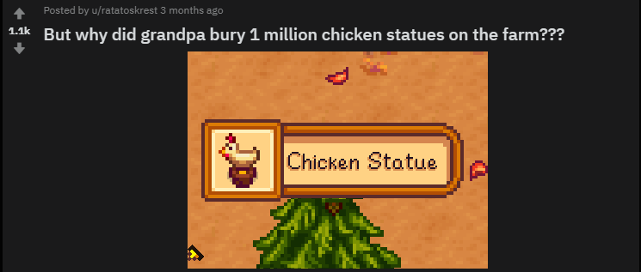
Sentiment Analysis
Most Positive Post Replies (56% pos)
Notes:
Compared to 79%

Slide 36
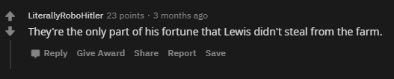

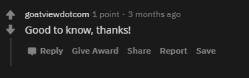
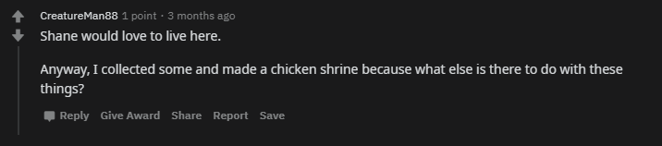
Sentiment Analysis
Most Positive Post Replies (56% pos)
Notes:
Compared to 79%

Slide 37
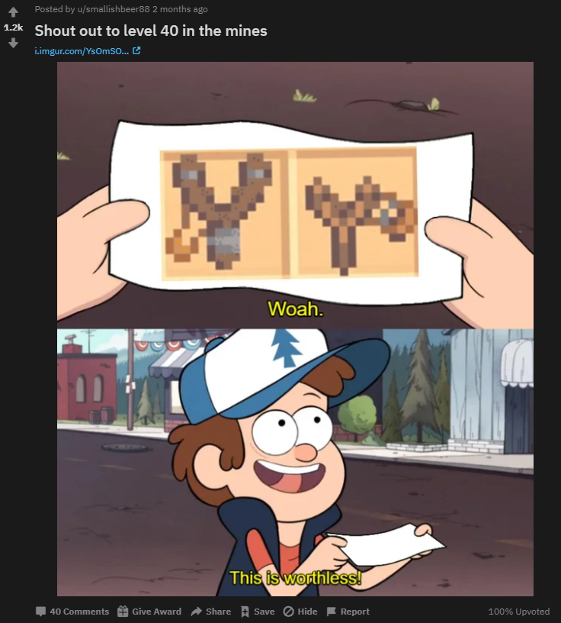
Sentiment Analysis
Most Negative Post Replies (40% neg)
Notes:
Compared to 25%

Slide 38
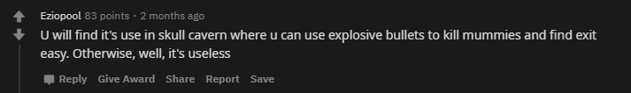
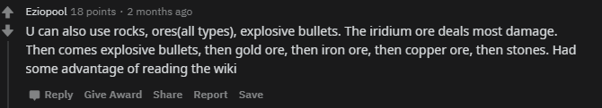

Sentiment Analysis
Most Negative Post Replies (40% neg)
Notes:
Note the 50

Slide 39

Notes:
Any final things you want to tell us

